Slide 1

Netflix Dataset Analysis
Name: Vivek Suresh Lokolakar
AICTE Internship Id: STU6717b01043d191729605648
Apply Id: APPLY_175576751568a6e2dbc1af5

Slide 2

PROBLEM STATEMENT
Netflix has become one of the most prominent global streaming platforms, continuously expanding its library with a mix of original productions and licensed content. However, with growing competition from platforms like Amazon Prime, Disney+, and regional OTT providers, Netflix must strategically analyze its content catalog to identify strengths, gaps, and opportunities.

Slide 3
Project Description
The Netflix Content Trends Analysis Project explores Movies and TV Shows released on Netflix between 2008 and 2021 using a dataset of 7,789 records. The project examines Movies vs. TV Shows distribution, content trends over time, genre popularity, country contributions, and ratings.
Using Python (Pandas, Matplotlib, Seaborn), the data is cleaned and visualized through bar charts and pie charts. The analysis provides insights into Netflix’s strengths, gaps, and opportunities, helping to guide strategic content planning.
Key outcomes include identifying top genres, country-wise representation, and audience targeting patterns, with recommendations for Netflix to expand genres, balance Movies and TV Shows, and strengthen global reach.

Slide 4

WHO ARE THE END USERS?
The Netflix Content Trends Analysis Project is useful for multiple stakeholders, including:
Netflix Content Strategists & Decision Makers → To plan future content production and acquisitions.
Data Analysts & Researchers → To study OTT content trends and audience preferences.
Media & Entertainment Companies → To benchmark their strategies against Netflix.
Students & Learners → To practice data analysis, visualization, and storytelling with real-world datasets.
General Audience & Netflix Enthusiasts → To understand how Netflix’s content library has evolved over time.

Slide 5

Technology Used
The project is implemented using the following technologies:
Python 3 → Core programming language for analysis.
Pandas → Data cleaning, transformation, and preprocessing.
Matplotlib → Data visualization (bar charts, pie charts, line graphs).
Seaborn → Advanced visualizations with statistical insights.
Jupyter Notebook → Interactive development and reporting environment.
These tools together enable efficient data exploration, visualization, and storytelling to extract meaningful insights from the Netflix dataset.

Slide 6
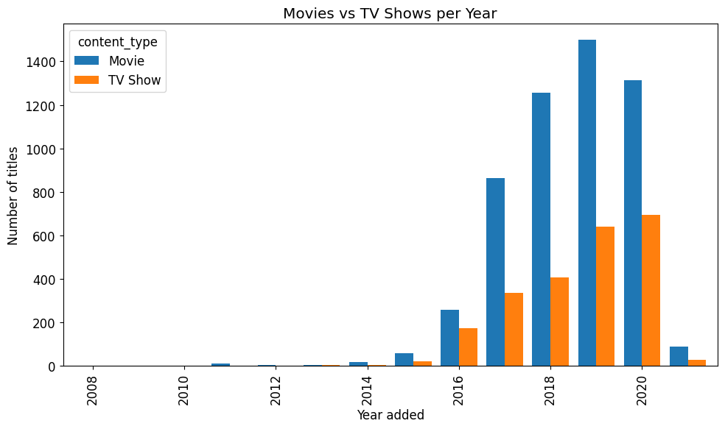
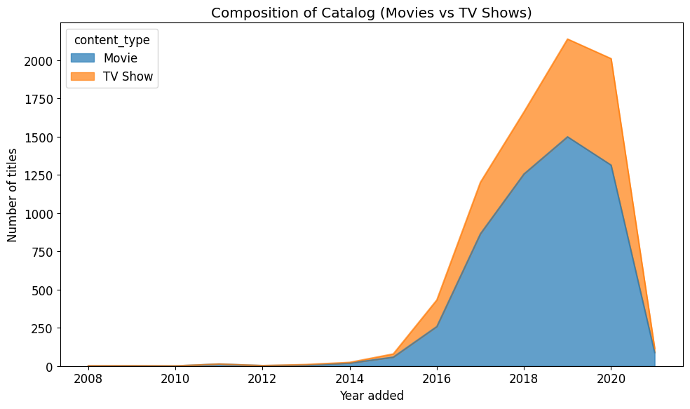
RESULTS1

Slide 7
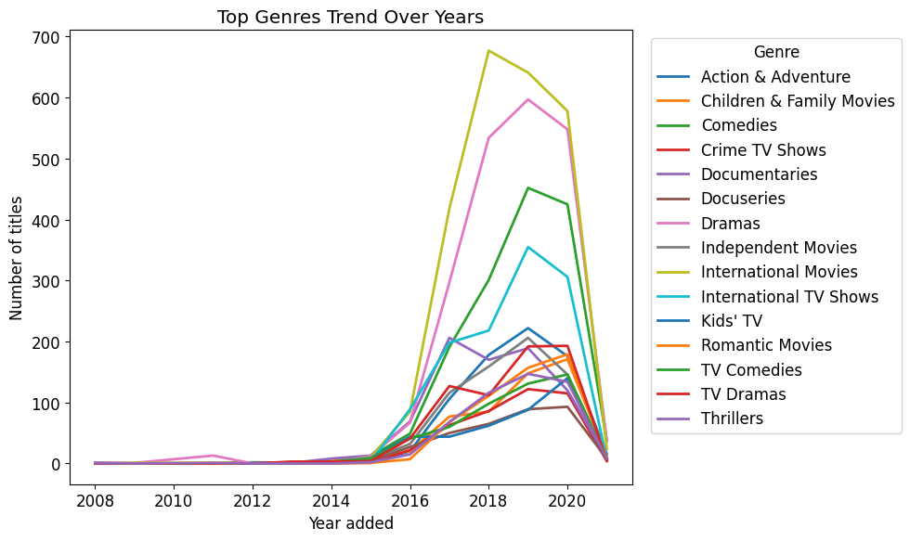
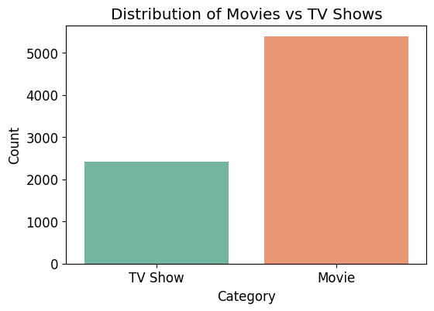
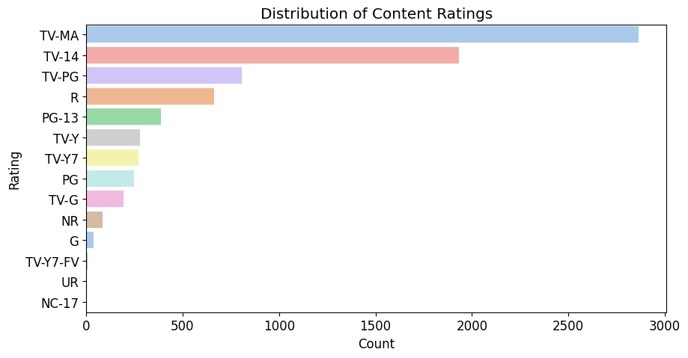
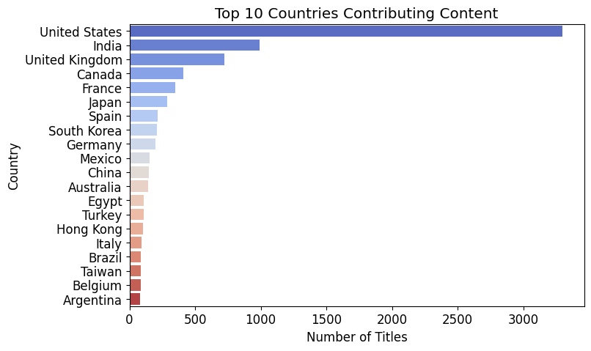
RESULTS2

Slide 8
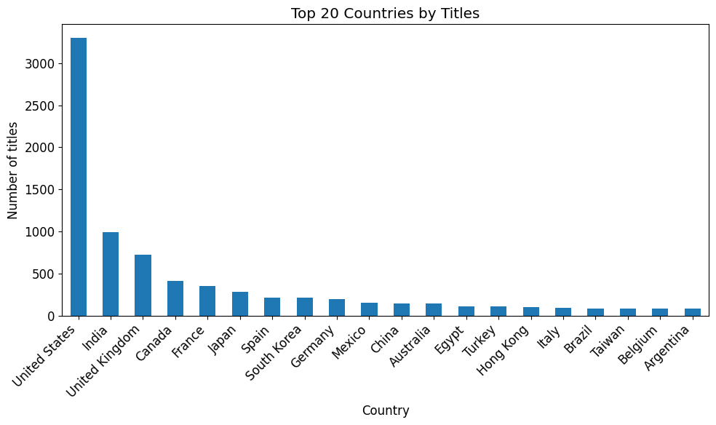
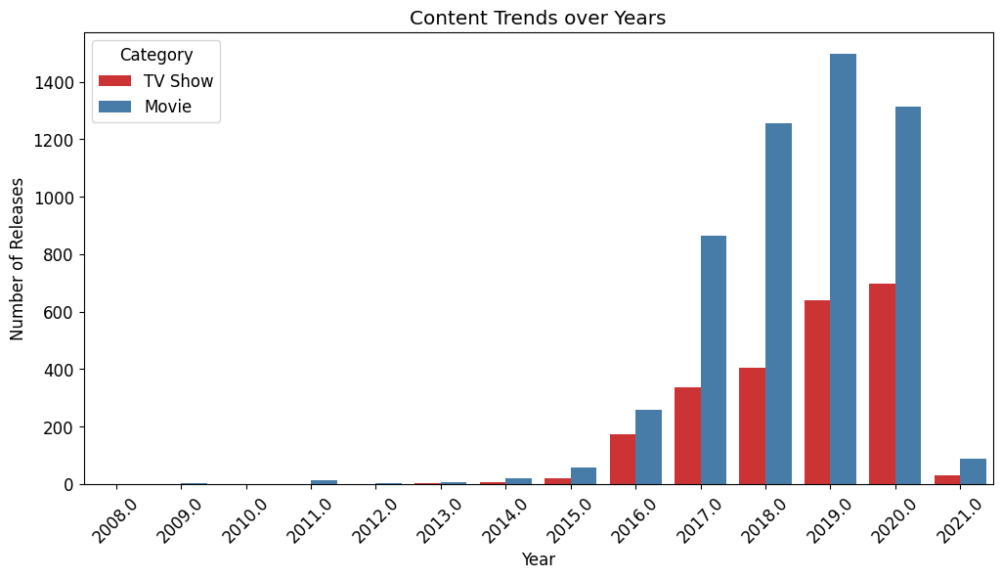
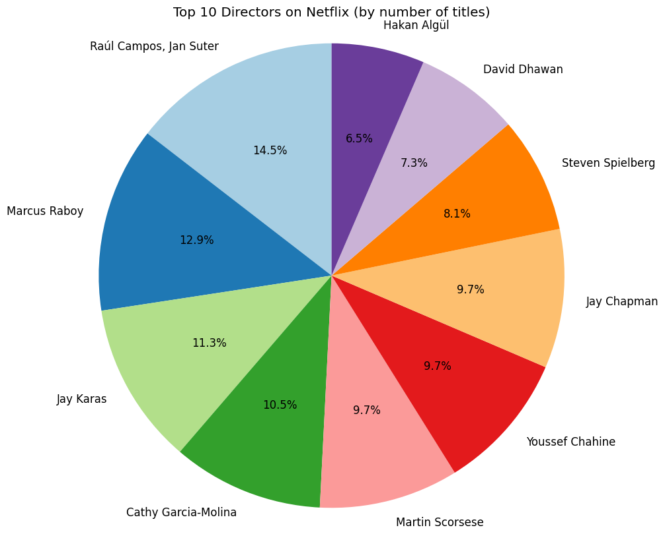
RESULTS3

Slide 9
GitHub repository
GitHub Repo:
https://github.com/vivek8085/VOIS_AICTE_Oct2025_MajorProject_Vivek-Suresh-Lokolakar.git

Slide 10
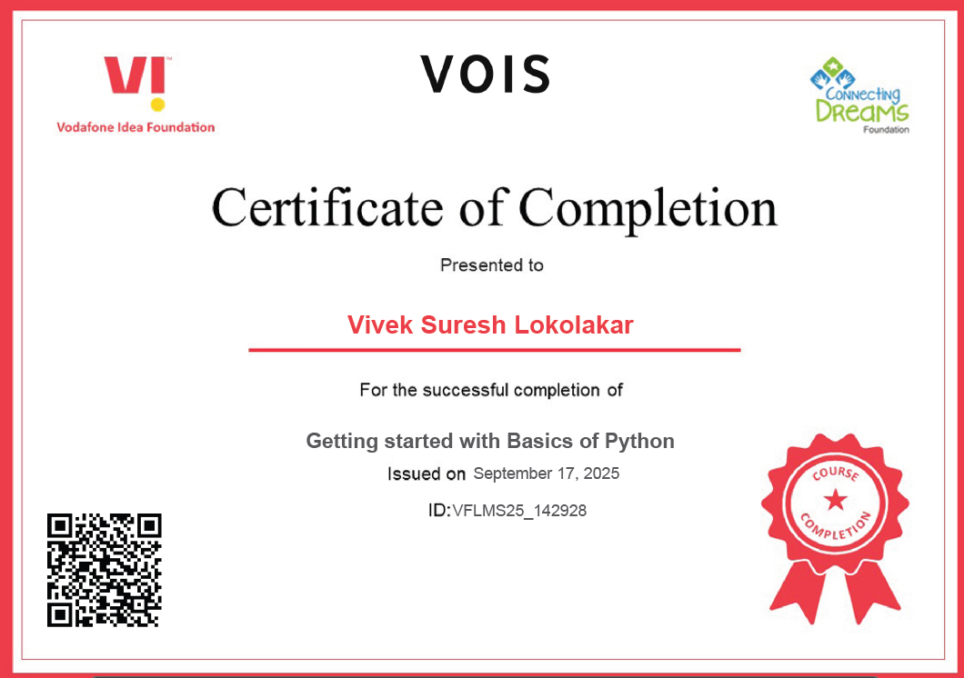
Getting started with Basics of Python Certificate

Slide 11
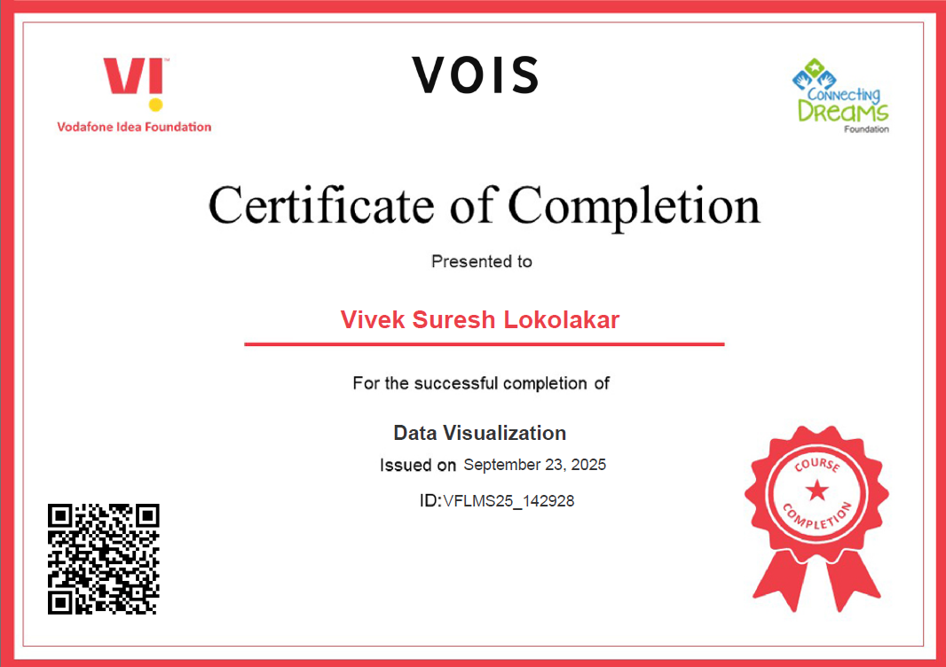
Data Visualization Certificate

Slide 12
Thank you
.

